Slide 1
PolluxPenguin
emini

Slide 2
Streamline Workflows
PolluxPenguin
et tasks done
It’s that simple

Slide 3
How do drones receive instructions?

Slide 4
How do drones receive instructions?
Ground Station
drone
Mavlink messages
(Any Computer, server, which has hardware that connects to the drone’s microcontroller)

Slide 5
Mavlink messages
Special communication Protocol which is used by most open source autopilot firmware distributions
Is basically text in a particular format that the drone’s firmware can interpret

Slide 6
Is basically text in a particular format that the drone’s firmware can interpret
Traditonally, we have always used API and function calls to generate text as per our requirements
But now, we have a better way of generating text as per our requirements
Large Language Models

Slide 7
Core Components
App/frontend
LLM
Controller – interprets to MAVLINK
Vision modules

Slide 8
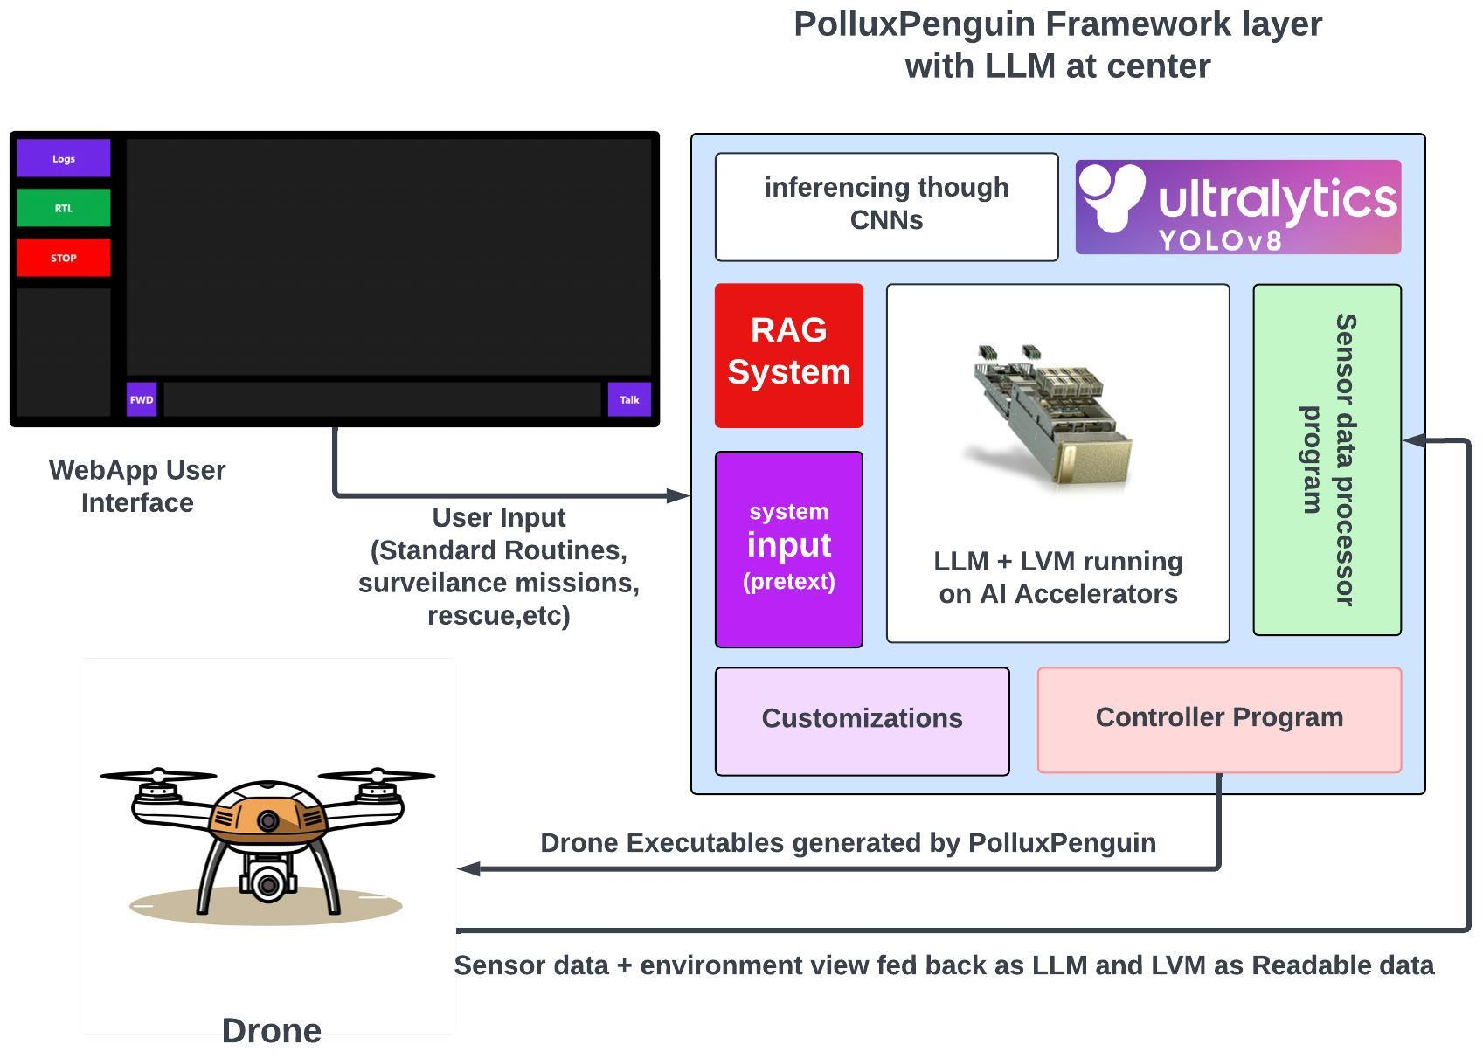

Slide 9
APPLICATIONS
emini

Slide 10
A REVOLUTION IN AERIAL EMERGENCY SERVICES
emini

Slide 11
Revolutionizing Rescue Missions
1
Rapid Response
Drones can be deployed quickly to reach remote or inaccessible areas, providing vital aid and support during emergency situations.
2
Aerial Surveillance
PolluxPenguin-powered drones can survey disaster zones, identify survivors, and guide rescue teams to maximize the effectiveness of rescue efforts.
3
Delivery of Supplies
Drones can transport essential supplies, such as medical kits, food, and water, directly to those in need during emergency situations.

Slide 12
1
2
3
Rapid Response
Aerial Surveillance
Delivery of Supplies

Slide 13
IN AN EMERGENCY
emini

Slide 14
IN AN EMERGENCY
emini
CONTEXT IS KEY

Slide 15
1
2
3
Rapid Response
Aerial Surveillance
Delivery of Supplies

Slide 16
CONTEXT
CONTEXT
1
2
3
Rapid Response
Aerial Surveillance
Delivery of Supplies

Slide 17
CONTEXT
IS THE GAP
POLLUXPENGUIN
BRIDGES IT

Slide 18
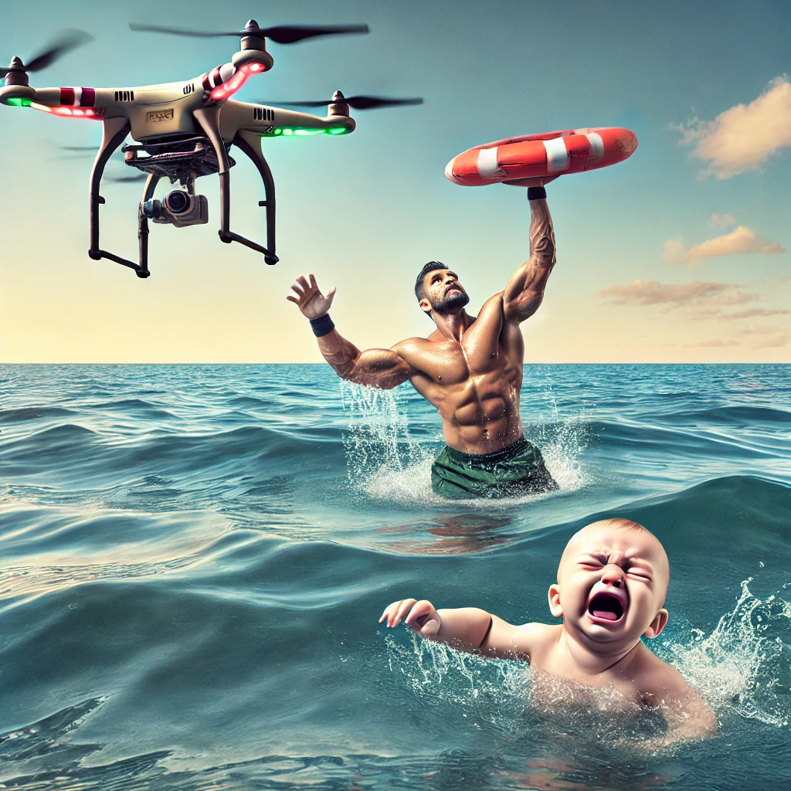
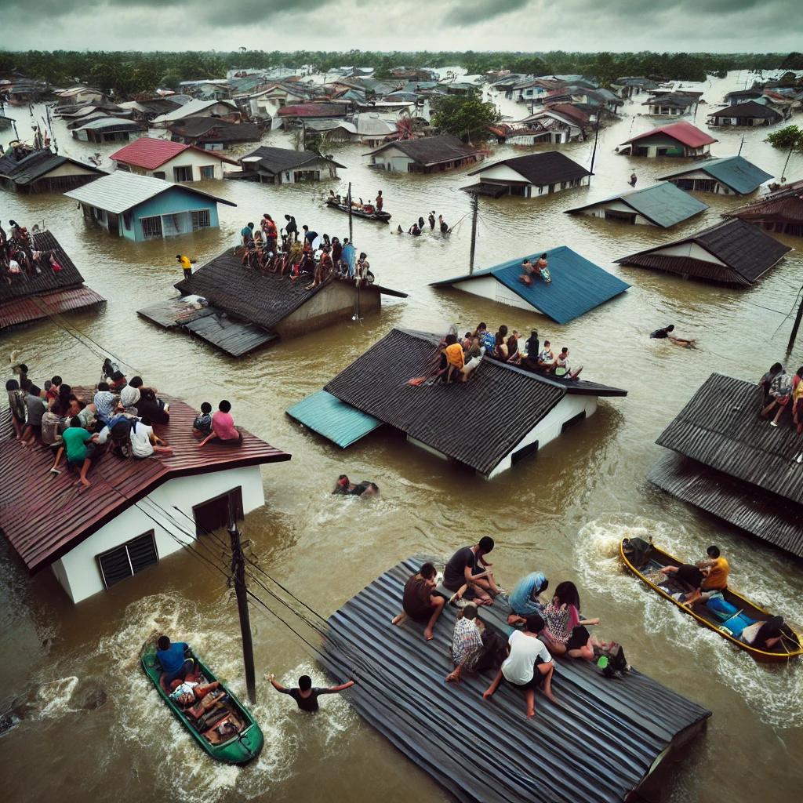

Slide 19
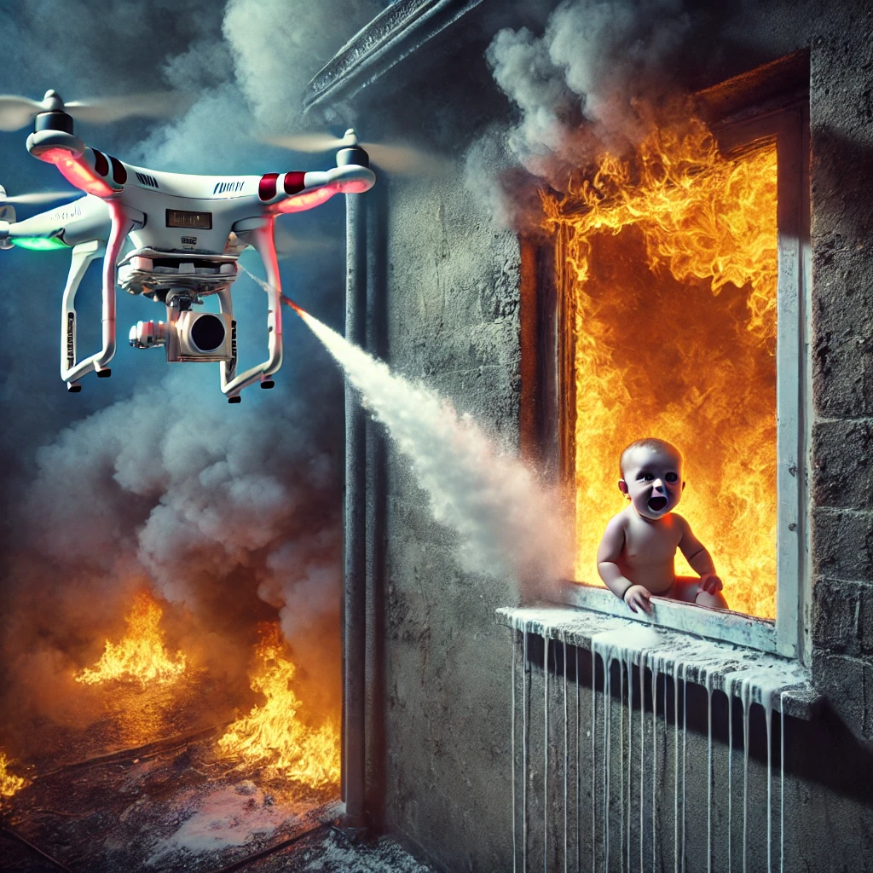

Slide 20


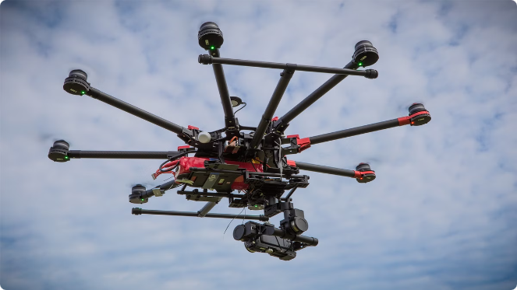


Empowering Filmmakers
Aerial Cinematography
PolluxPenguin's user-friendly interface allows filmmakers to capture breathtaking aerial footage without the need for extensive drone piloting skills.
Artistic Expression
Drones equipped with PolluxPenguin's advanced capabilities unlock new creative possibilities, enabling filmmakers to tell their stories in innovative ways.
Streamlined Production
PolluxPenguin's automated flight and stabilization features save filmmakers time and resources, allowing them to focus on their craft.

Slide 21

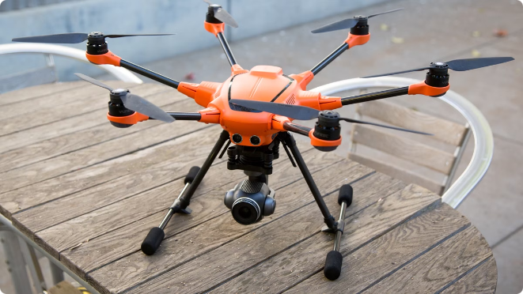
Versatile Applications
1
Agricultural Monitoring
PolluxPenguin-equipped drones can provide farmers with real-time data on crop health, irrigation needs, and pest management, optimizing agricultural operations.
2
Infrastructure Inspection
Drones can be used to inspect bridges, power lines, and other infrastructure, helping to identify potential issues and prioritize maintenance efforts.
3
Environmental Conservation
PolluxPenguin's drones can assist in wildlife tracking, habitat monitoring, and anti-poaching efforts, contributing to the preservation of natural ecosystems.

